Slide 1

Web Programming Fundamentals
By Aniket Metkari – 22101A2001

Slide 2

Web Browser
A web browser is a software application that allows users to access and interact with information on the World Wide Web. It acts as an interface between the user and the web, enabling users to view web pages, download files, and interact with web-based applications.
When the web browser fetches data from an internet connected server, it uses a piece of software called a rendering engine to translate that data into text and images. This data is written in Hypertext Markup Language (HTML) and web browsers read this code to create what we see, hear and experience on the internet.

Slide 3

HTTP Protocol
HTTP (Hypertext Transfer Protocol) is a protocol used for transmitting data over the World Wide Web. It defines the rules and conventions for communication between web clients (typically web browsers) and web servers. Here's a description of the HTTP protocol:
1. Client-Server Model: HTTP operates within a client-server model, where a client (usually a web browser) sends requests to a server, and the server responds with the requested data.
2. Request-Response Cycle: When you enter a URL in your web browser and hit Enter, it sends an HTTP request to the web server associated with that URL. The server processes the request and sends back an HTTP response containing the requested data.
3. Methods: HTTP requests use different methods
(also known as verbs) to specify the type of operation to be performed.

Slide 4

HTTPS
HTTPS, or Hypertext Transfer Protocol Secure, is a secure and encrypted version of the standard HTTP (Hypertext Transfer Protocol) used for transmitting data over the World Wide Web. It adds a layer of security to the communication between a web client (such as a web browser) and a web server.
Features of HTTPS:
1. Privacy: HTTPS guarantees the privacy and confidentiality of user data during transmission, preventing unauthorized access to sensitive information.
2. Securing Cookies: Cookies sent by HTTPS websites are also secure, making it difficult for attackers to steal session cookies and hijack user sessions.
3. Protection Against Phishing: HTTPS helps protect against phishing attacks by ensuring users are connecting to legitimate websites with valid certificates.

Slide 5
HTTPS
4. Data Encryption: The primary advantage of HTTPS is data encryption. It ensures that data transmitted between the web client and server is securely encoded, making it unreadable to unauthorized parties.
5. Secure Transactions: HTTPS is essential for e-commerce websites, online banking, and any site that handles financial transactions. It ensures that sensitive financial and payment information is kept secure.
6. Authentication: HTTPS provides authentication, allowing the client to verify the identity of the server it's communicating with.

Slide 6

XML Introduction
XML, or eXtensible Markup Language, is a versatile and widely-used markup language designed to store and transport structured data. XML is often used to describe and encode information in a format that is both human-readable and machine-readable. It is a plain text format, making it platform-independent and easily parseable by software.
Key characteristics of XML include:
1. Extensibility: XML is "extensible" because it allows users to define their own customized tags and document structures.
2. Tags and Elements: XML uses opening and closing tags enclosed in angle brackets ("<" and ">") to define elements. Elements can contain data or other elements.

Slide 7
XML
3. Platform-Independent: XML is platform-independent, meaning it can be used on various operating systems and transported across different networks.
4. Human-Readable: XML documents are designed to be easily readable by humans, which is valuable for configuration files and data exchange where manual inspection may be required.
5. Data Interchange: XML is commonly used for data interchange between different systems and platforms. It can be used for sharing structured data across the internet

Slide 8

Json Introduction
JSON, which stands for "JavaScript Object Notation," is a lightweight, text-based data interchange format. It is designed to be easy for humans to read and write and easy for machines to parse and generate. JSON is a common data format used for structuring and exchanging data over the internet and is a popular alternative to XML (eXtensible Markup Language) for data serialization.
Key Elements of JSON:
Human-Readable
Lightweight
Data Exchange
Variety of Data Types

Slide 9
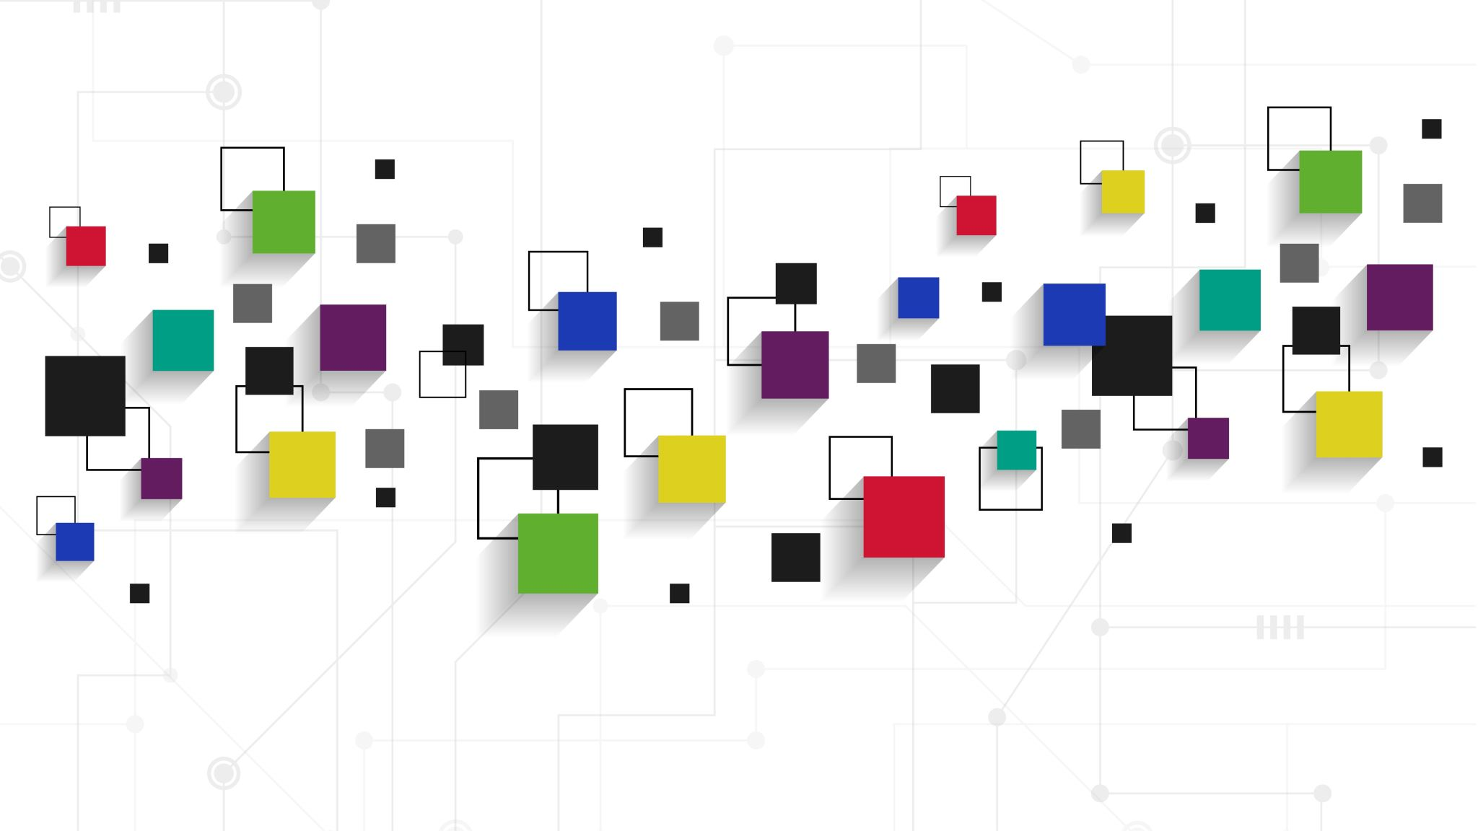
DOM (Document Object Model)
DOM, or Document Object Model, is a programming interface for web documents. It represents the structure and content of a web page as a tree-like data structure, where each node in the tree corresponds to a part of the web page, such as an element (e.g., a paragraph, a heading), an attribute, or a piece of text.
The DOM was designed to be independent of any particular programming language, making the structural representation of the document available from a single, consistent API.

Slide 10

URL (Uniform Resource Locator)
URL stands for Uniform Resource Locator. A URL is nothing more than the address of a given unique resource on the Web. In theory, each valid URL points to a unique resource. Such resources can be an HTML page, a CSS document, an image, etc. In practice, there are some exceptions, the most common being a URL pointing to a resource that no longer exists or that has moved.
Here Are some Examples:
https://www.google.com/
https://www.amazon.in/

Slide 11

Thank You!!

